Slide 1
M. Sc. PHYSICS (II Semester) Electrodynamics & Plasma Physics
Dr. Sanjeev Kumar Sharma

Slide 2
Laplace’s and Poisson Equations

Slide 3
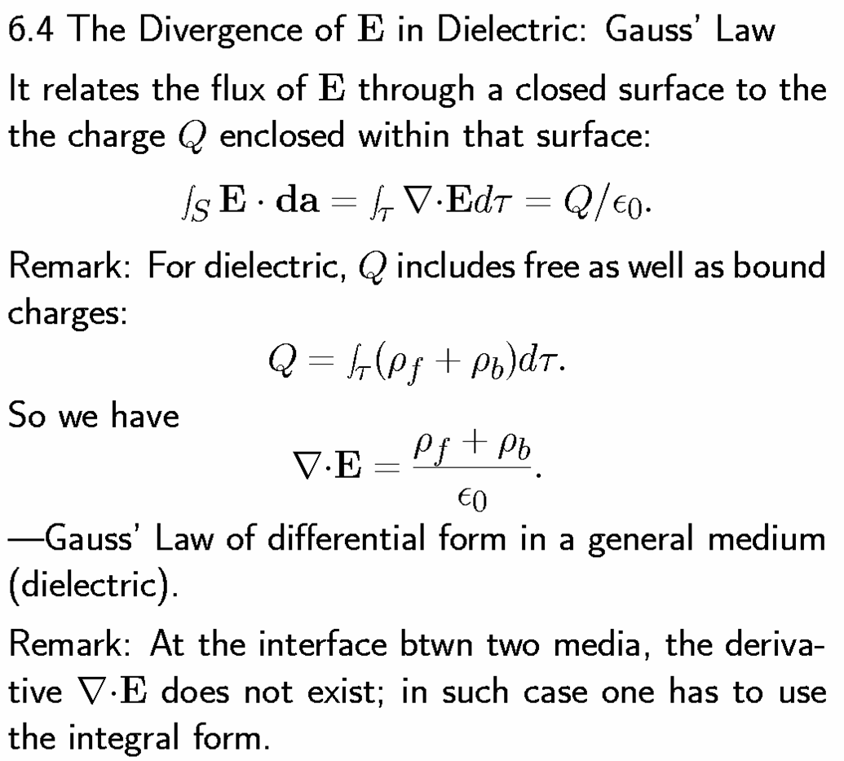
Divergence of E in Dielectric: Gauss’s Law

Slide 4
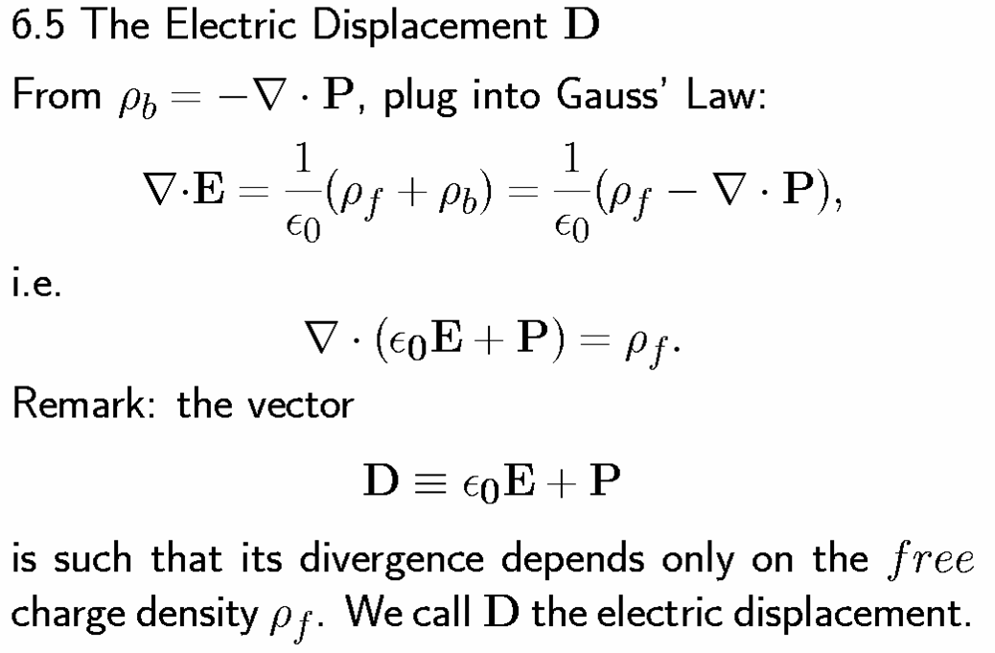
Electric Displacement: Gauss’s Law

Slide 5
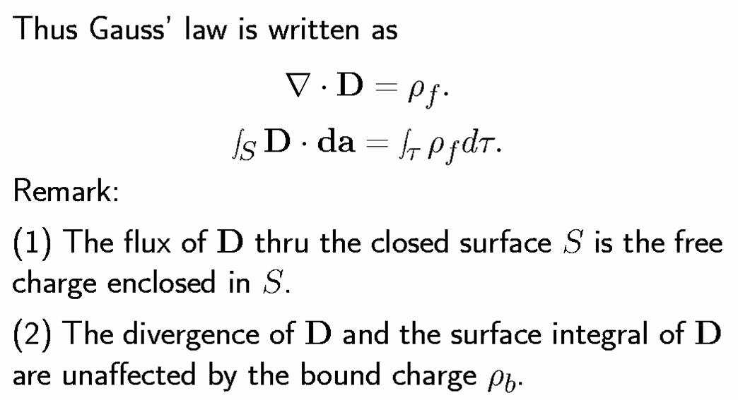

Slide 6
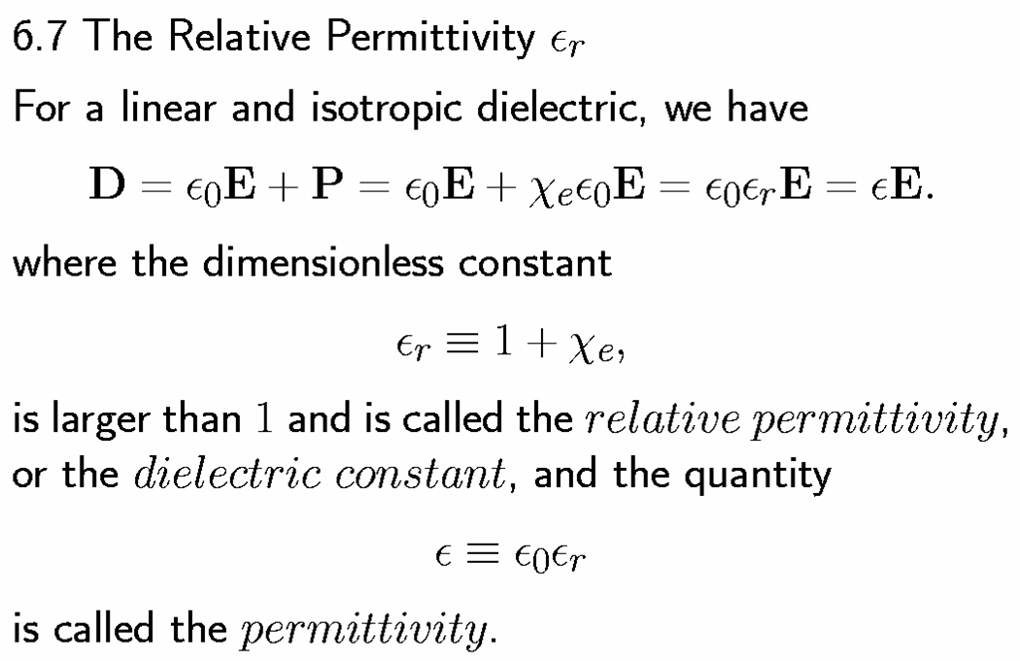
Relative Permittivity, ε_{r}

Slide 7
Gauss’s Law in integral form
Turn integral form into a differential one , by applying the divergence theorem
Gauss’s law in differential form,

Slide 8
Example: Two infinite parallel planes carry equal but opposite uniform charge densities .Find the field in each of the three regions.
Solution: The field is (σ/ε₀ ), and points to the right, between the plane elsewhere it is zero.

Slide 9
Introduction to potential
Any vector whose curl is zero is equal to the gradient of some scalar. We define a function:
Where is some standard reference point ; V depends only on the point P. V is called the electric potential.
The fundamental theorem for gradients
so

Slide 10
(1) Comments on potential
(1)The name
Potential is not potential energy
V : Joule/coulomb U : Joule

Slide 11
(2) Advantage of the potential formulation
V is a scalar function, but E is a vector quantity
If you know V, you can easily get E:
are not independent functions
so
1
2
3
1
2
3

Slide 12
(3)The reference point
Changing the reference point amounts to adds a constant to the potential
(Where K is a constant)
Adding a constant to V will not affect the potential difference between two point:
Since the derivative of a constant is zero:
For the different V, the field E remains the same.
Ordinarily we set

Slide 13
(4) Potential obeys the superposition principle
,
Dividing through by Q
Integrating from the common reference point to p ,
(5) Unit of potential
Volt = Joule/Coulomb
Joule/Coulomb

Slide 14
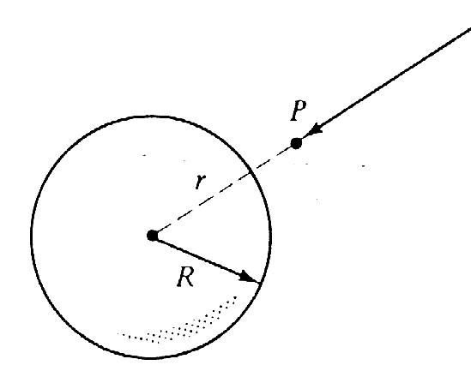
Example: Find the potential inside and outside a spherical shell of radius R, which carries a uniform surface charge (the total charge is q).
Solution:
for r > R:
_
For r < R:

Slide 15
Poisson’s Eq. & Laplace’s Eq.
Poisson’s Eq.
When
Laplace’s eq.

Slide 16
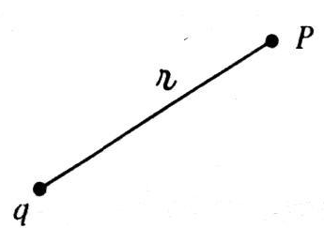
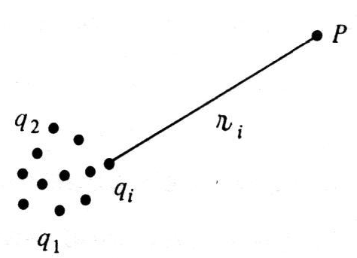
The Potential of a Localized Charge Distribution
Potential for a point charge
R
Potential for a collection of charge
R_{i}

Slide 17
Potential of a continuous distribution
for volume charge for a line charge for a surface charge
Corresponding electric field
[
]

Slide 18
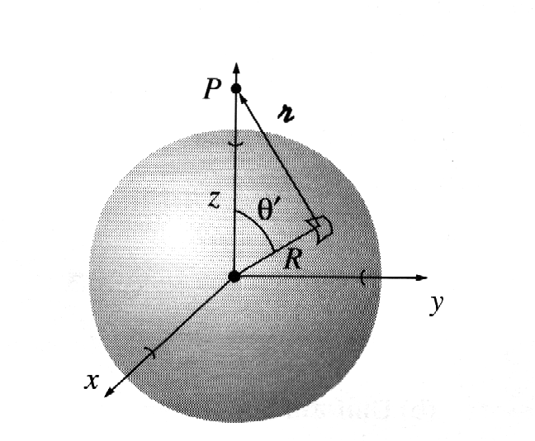
Example: Find the potential of a uniformly charged spherical shell of radius R.
Solution:
r

Slide 20
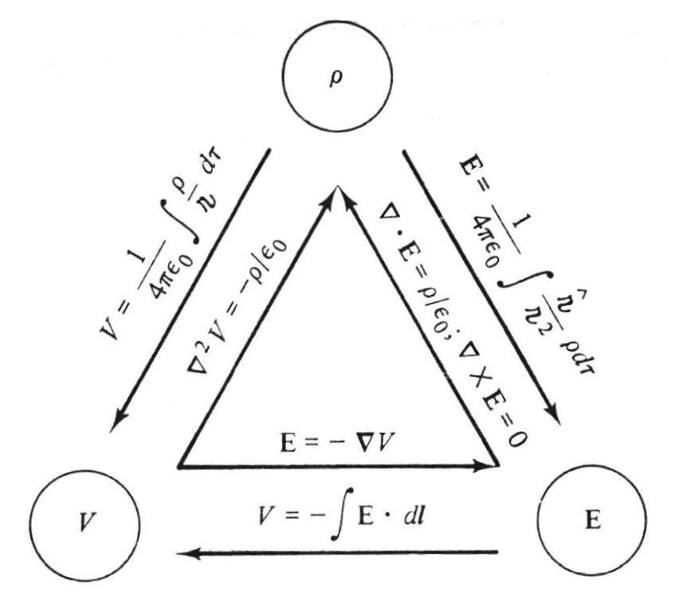
Electrostatic Boundary Condition
Electrostatic problem
Superposition
Coulomb law
The above equations are differential or integral. For a unique solution, we need boundary conditions. (e.q. , V(∞)=0), (boundary value problem: initial value problem.)

Slide 21
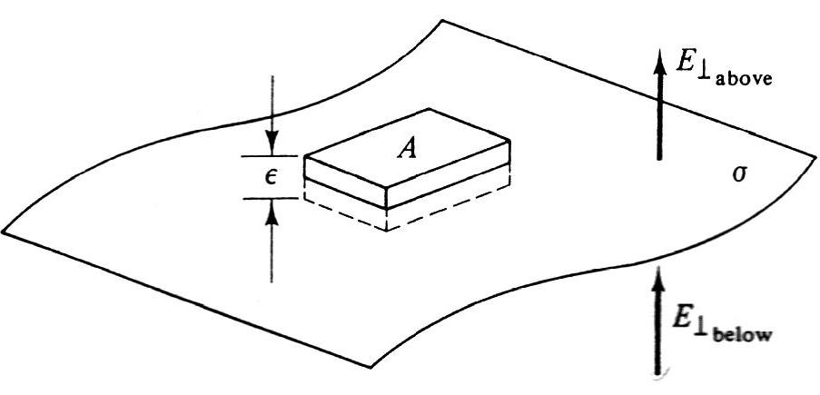
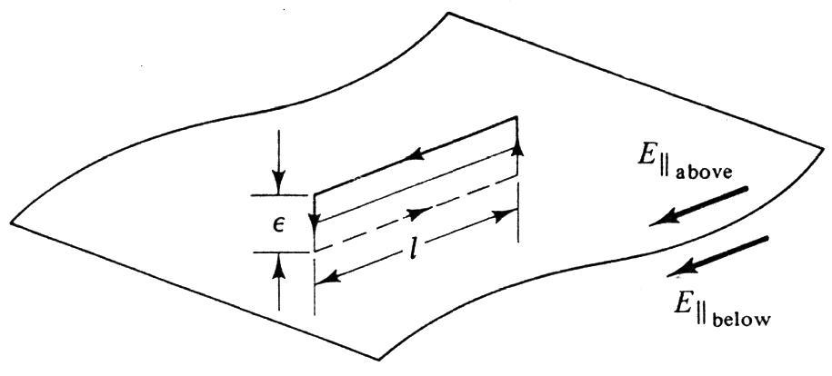
Boundary Condition at surface with charge
:
=
∥:
E_{‖ above}= E_{‖ below}
+∥

Slide 22
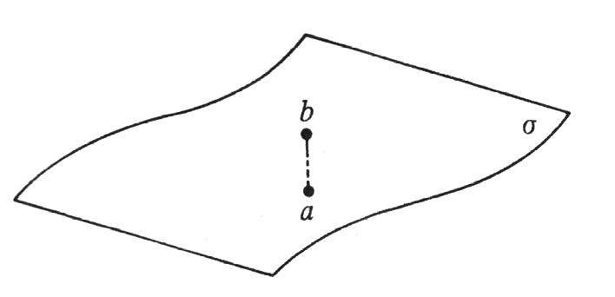
Potential Boundary Condition

Slide 23
Thanks

